Slide 1
Evolutionary Algorithms Visualization
Group 5:
Lương Minh Triết
Phạm Vũ Huy
Nguyễn Xuân Phong

Slide 2
Programm’s Functionality
Randomly generate items.
Choose one over three algorithms to visualize.
Run the algorithm.
Run the algorithm step by step.
Display.

Slide 3
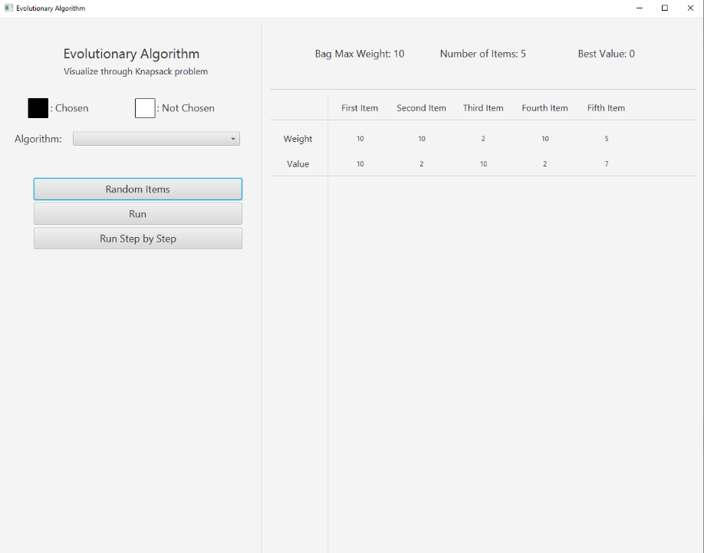
1. Randomly generate items
User choose the Random Items button to randomize the Items’ weights and values.

Slide 4
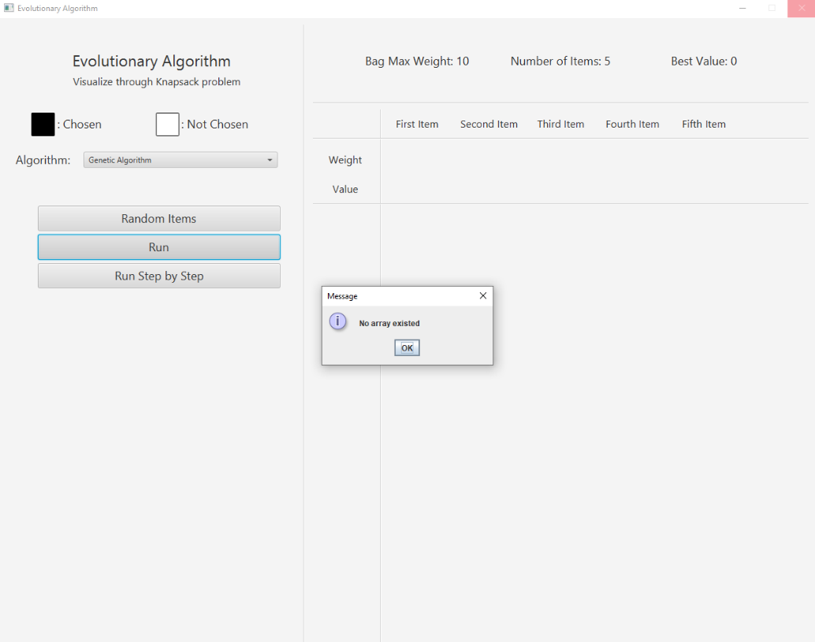
1. Randomly generate items
If the user does not choose the Random Items and one Algorithm but chooses Run or Run Step by Step instead, there will be a pop-up window saying that you should create items first.

Slide 5
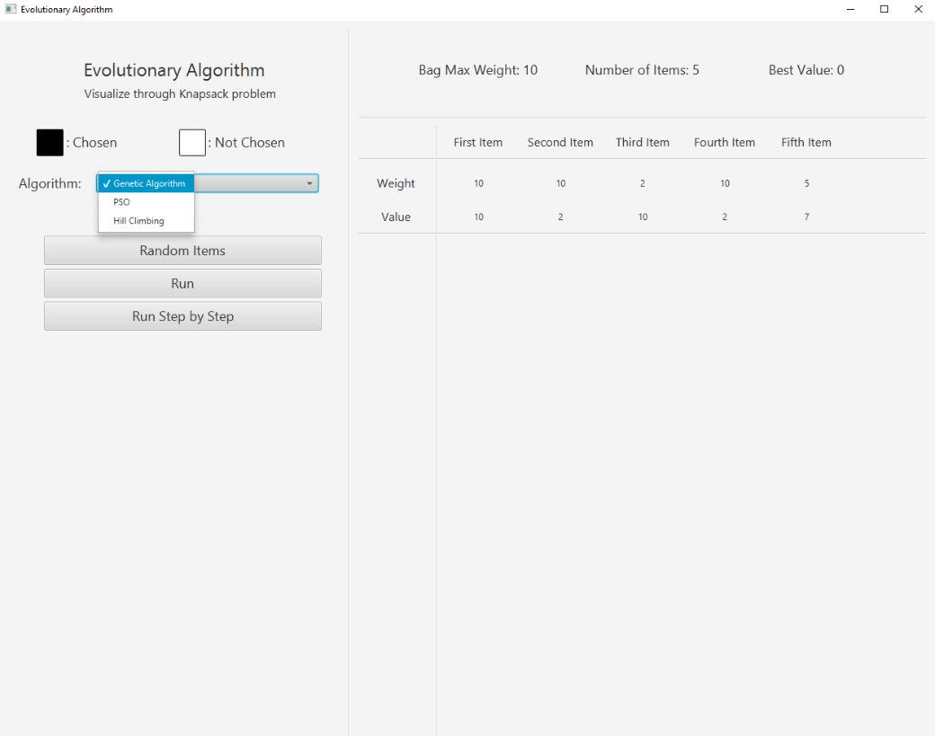
2. Choosing Algorithm
User picks one over three Algorithms: Genetic Algorithm, PSO or Hill Climbing for the program to visualize.

Slide 6
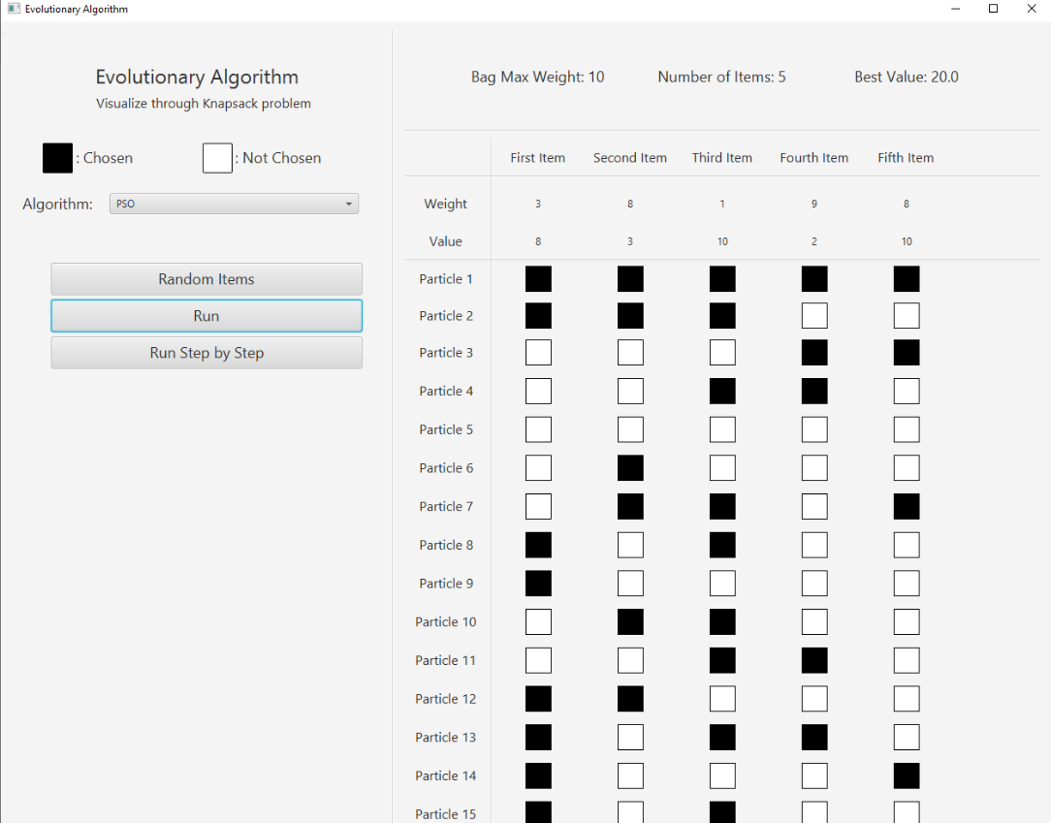
3. Run the Algorithm
User clicks the button Run to run the Algorithm automatically and have the result imidiately after chooses the Algorithm and creates items.

Slide 7
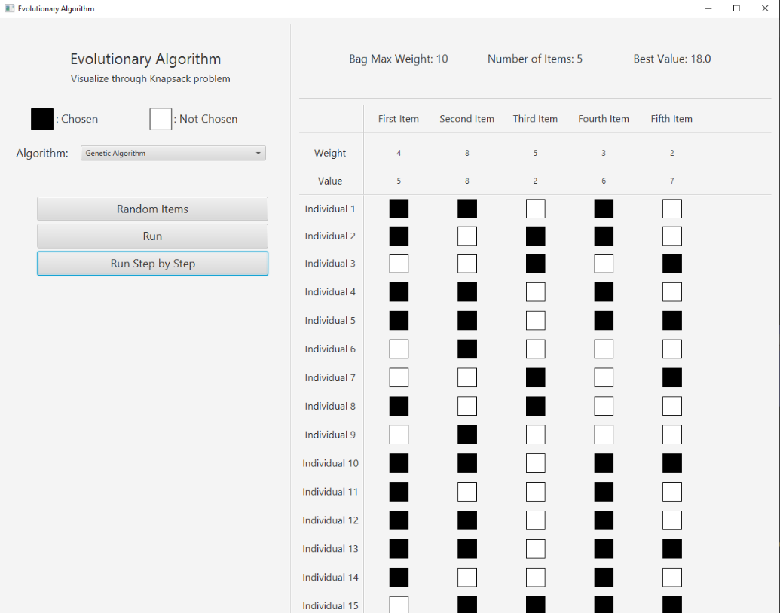
4. Run Step by Step
User clicks the button Run Step by Step to run the Algorithm auto-matically after chooses the Algorithm and creates items.
For Run Step by Step, after clicking the button, the program will display each step, to see the next step, the user must click Run Step by Step again.

Slide 8
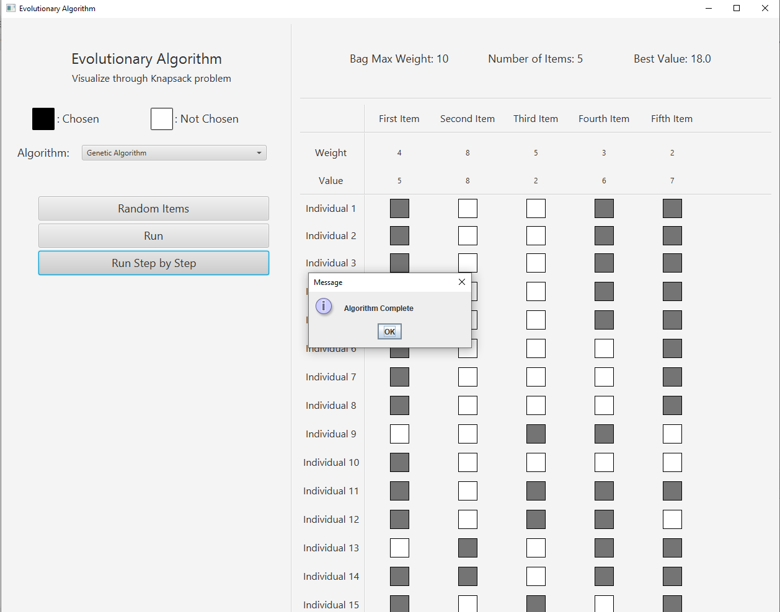
4. Run Step by Step
If it reaches the end of the Algorithm, there will be a notification:

Slide 9
How the program works
User clicks Random Items button to create items with values and weights.
User chooses one over three algorithms from Choice box.
User can choose Run or Run Step by Step:
For Genetic Algorithm, the termination condition happens when the number of steps reaches 20 or there are more than 30% of the individuals.
For PSO and Hill Climbing, the termination condition happens when the number of steps reaches 25.

Slide 10
Thank you for listening!

